Slide 1
PL/SQL
PL/SQL is a block-structured language. That is, the basic units (procedures, functions, and anonymous blocks) that make up a PL/SQL program are logical blocks, which can contain any number of nested sub-blocks.
Typically, each logical block corresponds to a problem or subproblem to be solved.
PL/SQL supports the divide-and-conquer approach to problem solving called stepwise refinement.
A block (or sub-block) lets you group logically related declarations and statements. That way, you can place declarations close to where they are used.
The declarations are local to the block and cease to exist when the block completes.

Slide 2
Structure of PL/SQL Block
PL/SQL block has three parts: a declarative part, an executable part, and an exception-handling part. (In PL/SQL, a warning or error condition is called an exception.) Only the executable part is required.
declare
<declarations section>
begin
<executable commands>
exception
<exception handling>
end;

Slide 3
Structure of PL/SQL Block
The order of the parts is logical. First comes the declarative part, in which items can be declared. Once declared, items can be manipulated in the executable part. Exceptions raised during execution can be dealt with in the exception-handling part.
You can nest sub-blocks in the executable and exception-handling parts of a PL/SQL block or subprogram but not in the declarative part.
you can define local subprograms in the declarative part of any block. However, you can call local subprograms only from the block in which they are defined.

Slide 4
Variables and Constants
PL/SQL lets you declare constants and variables, then use them in SQL and procedural statements anywhere an expression can be used. However, forward references are not allowed. So, you must declare a constant or variable before referencing it in other statements, including other declarative statements.
Variables can have any SQL datatype, such as CHAR, DATE, or NUMBER, or any PL/SQL datatype, such as BOOLEAN.
For example, assume that you want to declare a variable named part_no to hold 4-digit numbers and a variable named in_stock to hold the Boolean value TRUE or FALSE. You declare these variables as follows:
part_no NUMBER(4);
in_stock BOOLEAN;

Slide 5
Assigning Values to a Variable
You can assign values to a variable in three ways. The first way uses the assignment operator (:=), a colon followed by an equal sign. You place the variable to the left of the operator and an expression (which can include function calls) to the right. Examples :
tax := price * tax_rate;
valid_id := FALSE;
bonus := current_salary * 0.10;

Slide 6
Assigning Values to a Variable
The second way to assign values to a variable is by selecting (or fetching) database values into it. In the example below, you have Oracle compute a 10% bonus when you select the salary of an employee.
Now, you can use the variable bonus in another computation or insert its value into a database table.
SELECT sal * 0.10 INTO bonus FROM emp WHERE empno = emp_id;

Slide 7
Assigning Values to a Variable
The third way to assign values to a variable is by passing it as an OUT or IN OUT parameter to a subprogram. As the following example shows, an IN OUT parameter lets you pass initial values to the subprogram being called and return updated values to the caller:
DECLARE
my_sal REAL(7,2);
PROCEDURE adjust_salary (emp_id INT, salary IN
OUT REAL)
BEGIN
SELECT AVG(sal) INTO my_sal FROM emp;
adjust_salary(7788, my_sal);
End

Slide 8
Example of PL/SQL
declare
pi constant NUMBER(9,7) := 3.1415927;
radius INTEGER(5);
area NUMBER(14,2);
begin
radius := 3;
area := pi*power(radius,2);
insert into AREAS values (radius, area);
end;

Slide 9
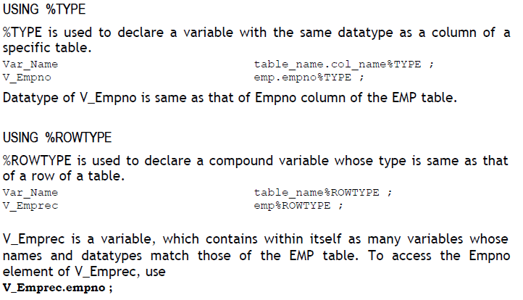
% Type and %ROWTYPE Declaration

Slide 10
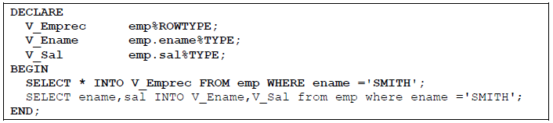
% Type and %ROWTYPE Declaration

Slide 11
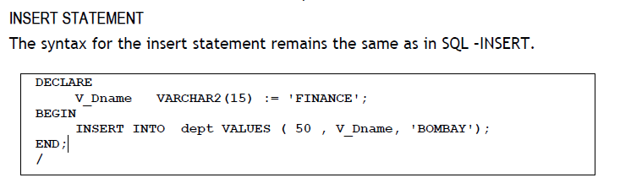

Slide 12
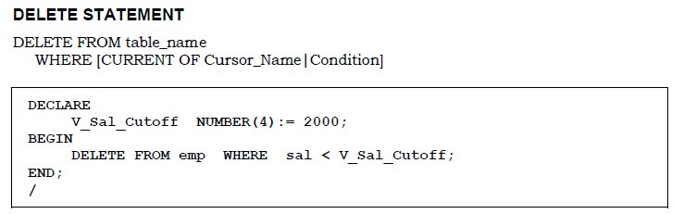

Slide 13
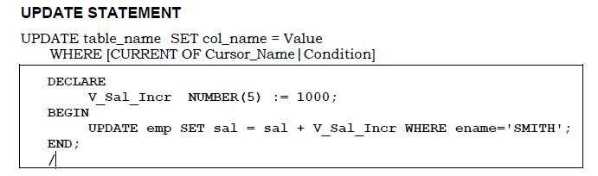

Slide 14
EXAMPLE:1
WRITE A PROGRAM TO PRINT HELLO WORLD
BEGIN
DBMS_OUTPUT.PUT_LINE ('HELLO WORLD');
END;

Slide 15
Example :-2
DECLARE
my_var VARCHAR(30);
BEGIN
my_var:=‘JOHN';
FOR i IN 1..5 LOOP
dbms_output.put_line('Hello '||my_var);
END LOOP;
END;

Slide 16
Retrieving Data in PL/SQL
Return the sum of the salaries for all employees in the specified department.
Example
DECLARE
v_sum_sal emp.sal%TYPE;
v_deptno NUMBER NOT NULL := 10;
BEGIN
SELECT SUM(sal) -- group function
INTO v_sum_sal
FROM emp
WHERE deptno = v_deptno;
END;
Notes:
Guidelines (continued)
To ensure that the datatypes of the identifiers match the datatypes of the columns, use the %TYPE attribute. The datatype and number of variables in the INTO clause match those in the SELECT list.
Use group functions, such as SUM, in a SQL statement, because group functions apply to groups of rows in a table.
Note: Group functions cannot be used in PL/SQL syntax. They are used in SQL statements within a PL/SQL block.
Instructor Note
On the board, write:
v_sum_salaries := SUM(emp.sal);
and draw a line through it to emphasize that group functions must be used in a SQL statement.

Slide 17
Updating Data
Increase the salary of all employees in the EMP table who are Analysts.
Example
DECLARE
v_sal_increase emp.sal%TYPE := 2000;
BEGIN
UPDATE emp
SET sal = sal + v_sal_increase
WHERE job = 'ANALYST';
END;
Notes:
Updating and Deleting Data
There may be ambiguity in the SET clause of the UPDATE statement because although the identifier on the left of the assignment operator is always a database column, the identifier on the right can be either a database column or a PL/SQL variable.
Remember that the WHERE clause is used to determine which rows are affected. If no rows are modified, no error occurs, unlike the SELECT statement in PL/SQL.
Note: PL/SQL variable assignments always use := and SQL column assignments always use =. Recall that if column names and identifier names are identical in the WHERE clause, the Oracle Server looks to the database first for the name.
Instructor Note
Demo: l18update.sql
Purpose: This example demonstrates using the UPDATE statement in an anonymous block.
Verify the change to the table. Enter SELECT * FROM emp.

Slide 18
Deleting Data
Delete rows that belong to department 10 from the EMP table.
Example
DECLARE
v_deptno emp.deptno%TYPE := 10;
BEGIN
DELETE FROM emp
WHERE deptno = v_deptno;
END;
Notes:
Deleting Data
Delete a specified order.
Instructor Note
Demo: l18delete.sql
Purpose: This example demonstrates using the DELETE statement in an anonymous block.
Verify the change to the table. Enter SELECT * FROM emp, where deptno is the department number and 'CLERK' is the job.
DECLARE
v_ordid ord.ordid%TYPE := 605;
BEGIN
DELETE FROM item
WHERE ordid = v_ordid;
END;

Slide 19
Writing Control Structures
FOR loop
BEGIN
FOR i IN 1..100 LOOP
……
END LOOP;
END;
WHILE loop
BEGIN
WHILE i <= 100 LOOP
……
END LOOP;
END;
Nested loop is allowed.

Slide 20
EXAMPLES ADDITION
Declare
a number;
b number;
c number;
begin
a:=3;
b:=5;
c:=a+b;
dbms_output.put_line('Sum of ' || a || ' and ' || b || ' is ' || c);
End;
Here & is used to take user input at runtime.....

Slide 21
SUM OF 100(1…100) NUMBERS
Declare
a number;
s1 number default 0;
Begin
a:=1;
Loop
s1:=s1+a;
exit when (a=100);
a:=a+1;
end loop;
dbms_output.put_line('Sum between 1 to 100 is '||s1);
End;

Slide 22
WAP to accept the empno and display all the details of emp. If emp does not exist display the message
DECLARE
EMPNOV NUMBER:=&EMPNO;
EMPV EMP%ROWTYPE;
BEGIN
SELECT * INTO EMPV FROM EMP WHERE EMPNO=EMPNOV;
DBMS_OUTPUT.PUT_LINE('EMPNO '||EMPV.EMPNO);
DBMS_OUTPUT.PUT_LINE('ENAME '||EMPV.ENAME);
DBMS_OUTPUT.PUT_LINE('JOB '||EMPV.JOB);
DBMS_OUTPUT.PUT_LINE('SALARY '||EMPV.SAL);
DBMS_OUTPUT.PUT_LINE('HIREDATE '||EMPV.HIREDATE);
DBMS_OUTPUT.PUT_LINE('DEPTNO '||EMPV.DEPTNO);
DBMS_OUTPUT.PUT_LINE('MGRNO '||EMPV.MGR);
DBMS_OUTPUT.PUT_LINE('COMMISSION '||EMPV.COMM);
EXCEPTION
WHEN NO_DATA_FOUND THEN
DBMS_OUTPUT.PUT_LINE('EMP NUMBER DOES NOT EXIST');
END;

Slide 23
In the following example, a cursor is declared to retrieve a record from the RADIUS_VALS table.
RADIUS_VALS is a table with one column, named Radius, that holds radius values to be used.
The cursor is declared in the Declarations section, and a variable named rad_val is declared with a datatype based on the cursor’s results.
For this example, the table RADIUS_VALS contains a single row with a Radius value of 3.

Slide 24
declare
pi constant NUMBER(9,7) := 3.1415927;
area NUMBER(14,2);
cursor rad_cursor is
select * from RADIUS_VALS;
rad_val rad_cursor%ROWTYPE;
begin
open rad_cursor;
fetch rad_cursor into rad_val;
area := pi*power(rad_val.radius,2);
insert into AREAS values (rad_val.radius, area);
close rad_cursor;
End;
When the rad_cursor cursor is opened, the query declared for that cursor is executed and the records to be returned are identified. Next, records are fetched from the cursor:

Slide 25
Simple Loops In the following listing, a simple loop is used to generate multiple rows in the AREAS table. The loop is started by the loop keyword, and the exit when clause determines when the loop should be exited. An end loop clause identifies the end of the loop.
declare
pi constant NUMBER(9,7) := 3.1415927;
radius INTEGER(5);
area NUMBER(14,2);
begin
radius := 3;
loop
area := pi*power(radius,2);
insert into AREAS values (radius, area);
radius := radius+1;
exit when area >100;
end loop;
end;

Slide 26
Cursor Loops
declare
pi constant NUMBER(9,7) := 3.1415927;
area NUMBER(14,2);
cursor rad_cursor is
select * from RADIUS_VALS;
rad_val rad_cursor%ROWTYPE;
begin
open rad_cursor;
loop
fetch rad_cursor into rad_val;
exit when rad_cursor%NOTFOUND;
area := pi*power(rad_val.radius,2);
insert into AREAS values (rad_val.radius, area);
end loop;
close rad_cursor;
end;

Slide 27
Trigger

Slide 28
create or replace trigger uprad_BEF_UPD_ROW
before update on radius_vals
for each row
begin
insert into upradius
(radius)
values
(:old.radius);
end;
update radius_vals
set radius=100 where radius=10;

Slide 29
create table BOOKSHELF
(Title VARCHAR2(100),
Publisher VARCHAR2(20),
CategoryName VARCHAR2(20),
Rating integer,
Audit_Date DATE);
create table BOOKSHELF_AUDIT
(Title VARCHAR2(100),
Publisher VARCHAR2(20),
CategoryName VARCHAR2(20),
oldRating integer,
newRating integer,
Audit_Date DATE);
insert into BOOKSHELF values('a','pub1','cat1',10,'14/may/2015')
insert into BOOKSHELF values('c','pub3','cat3',30,'14/july/2015')
create or replace trigger BOOKSHELF_BEF_UPD_ROW
before update on BOOKSHELF
for each row
when (new.Rating < old.Rating)
begin
insert into BOOKSHELF_AUDIT
(Title, Publisher, CategoryName,
OldRating, NewRating, Audit_Date)
values
(:old.Title, :old.Publisher, :old.CategoryName,
:old.Rating, :new.Rating, Sysdate);
end;
update bookshelf
set rating=25 where publisher='pub3';

